Slide 1
HORIZON 2020
Excellent Science
Global Challenges
Competitive Industries
Open to the world!

Slide 2
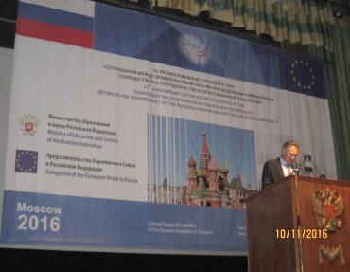
Framework for bilateral cooperation
Agreement on Cooperation in Science and Technology between the European Union and the Government of the Russian Federation (signed in 2000 and renewed in 2003, 2009 and 2014);
15th anniversary event (Nov. 2016);
Two Agreements between the European Atomic Energy Community and the Russian Government for co-operation on nuclear safety and on nuclear fusion (signed 2001).

Slide 3
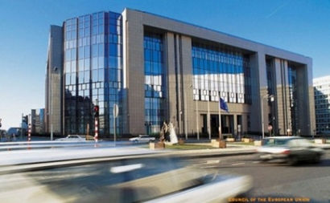
Foreign Affairs Council (14 March 2016)
"Need and willingness to engage in people-to-people contacts"..., including in education and culture, research and science cooperation, mobility, cross-border and transnational cooperation.

Slide 4
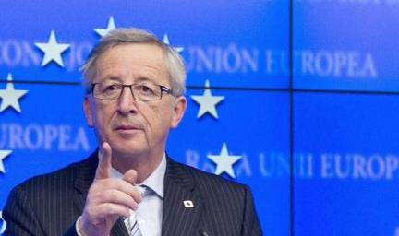
SPIEF 2016
"People must be at the heart" of the development of the region shared by Russia and the EU and "European civil society will continue to work with our Russian partners. We will deepen our cooperation in education, science, research and culture."

Slide 5
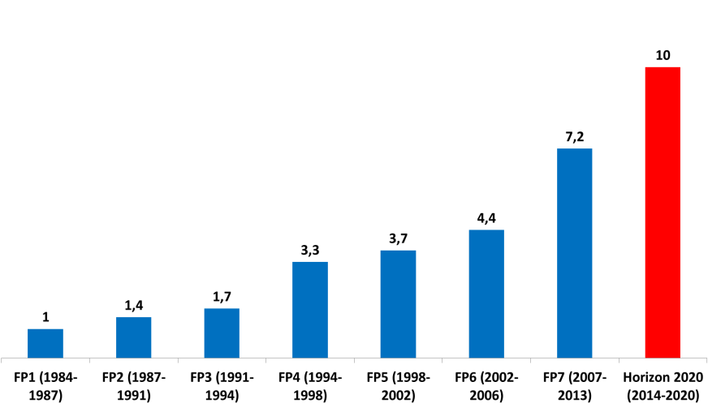
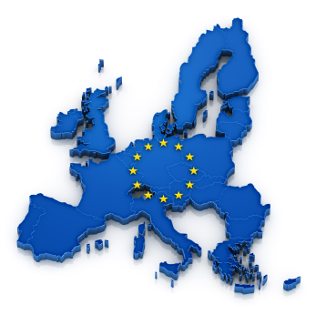

30 years of EU funded R&I
Amount in billions € per year

Slide 6
What is the EU's Horizon 2020 programme?
Almost €80 billion (current prices) research and innovation funding programme (2014-2020)
A core part of Europe 2020, Innovation Union & European Research Area
Investing in future jobs and growth
Addressing concerns about livelihoods, safety and environment
Strengthening the EU’s global position in research, innovation and technology
Coupling research to innovation – from research to retail,
all forms of innovation
Focus on societal challenges facing EU society, e.g. health,
clean energy, transport, climate change, food security and others
Open for participation to all companies, universities, institutes in
all EU countries and everywhere in the world!

Slide 7
H2020: Funding processes
Overall research priorities defined in the "EU Research & Innovation Framework Programmes" – currently Horizon 2020 (2014-2020). Published work programmes with list of topics.
Annual calls for proposals on topics defined jointly by the European Commission and EU Member States (in the so-called Programme Committees) upon input from the scientific advisory board and the scientific communities regularly consulted.
Evaluation of applications by panels of independent experts (3 evaluation criteria: Science & Technology; Expected Impact, Implementation & Management).
From call for proposal submission deadline to grant signature: max. 8 months.
Financial commitments/disbursements: Pre-financing followed by annual disbursements (on costs incurred).
Monitoring projects activities by EC staff (with addition of independent experts if necessary).

Slide 8
Horizon 2020: structure
  Horizon 2020 Prizes, Science for Society, Spreading Excellence, JRC, EIT, Euratom
Excellent Science
European Research Council
Future and Emerging Technologies
Industrial Leadership
Leadership in enabling and industrial technologies
(ICT, nano, materials, biotech, manufacturing, space)
Access to risk finance
Societal Challenges
Health
Marie Sklodowska-Curie actions
Research infrastructures
Innovation in SMEs
Food
Energy
Transport
Climate
Inclusive societies
Security

Slide 9
Horizon 2020: conditions of participation in projects
Standard minimum conditions
at least three legal entities
independent of each other
from different EU Member States or countries associated to the Framework Programme ('Associated Countries')
Partners from Russia may participate as 4th, 5th, 6th. … legal entity
Exceptions
CSAs, ERC etc.: at least one beneficiary
Additional criteria
may be specified in the Work Programme (see call text for further information) e.g.: at least one organisation from a particular 'third country'

Slide 10
Evaluation of proposals
STANDARD AWARD CRITERIA
EXCELLENCE
IMPACT
QUALITY &
EFFICIENCY
OF THE ACTION
For full proposals, each criterion will be scored out of 5. The threshold for individual criteria will be 3. The overall threshold, applying to the sum of the three individual scores, will be 10.
ERC frontier Research actions only "EXCELLENCE"
Innovation actions higher weighting for "IMPACT"

Slide 11
Horizon 2020: open to the world
Horizon 2020 is open to participation from across the world
Automatic EU funding for their participation in R&I actions for:
EU Member States (including overseas departments and overseas territories)
Associated Countries, such as Israel, Moldova, Norway, Serbia, Turkey, Switzerland, …
exhaustive list of countries in annex to work programme

Slide 12
Horizon 2020: open to the world (2)
For other countries (such as Australia, Brazil, Canada, China, India, Japan, Mexico, Russia, United States,…), EU funding for their participation in R&I actions only in exceptional cases:
    such funding is provided for in a bilateral scientific & technological cooperation or similar agreement
    funding for entities established in these countries is included in the call text (e.g. "… entities established in Russia … will be eligible to receive funding…")
    the Commission deems the participation of the entity essential for carrying out the project, for instance because it provides:
      outstanding competence / expertise
      access to (unique) research facilities / infrastructure
      access to a particular geographical environment
      access to (unique) data (sets)

Slide 13
Funding for Russian participants in Horizon 2020: Summary
Individual grants and fellowships under the Marie Sklodowska-Curie mobility programme and by the European Research Council (ERC) are available for Russian scientists
EU funding for Russian participants in collaborative R&I actions is possible on an exceptional basis or if explicitly stated in the call announcement

Slide 14
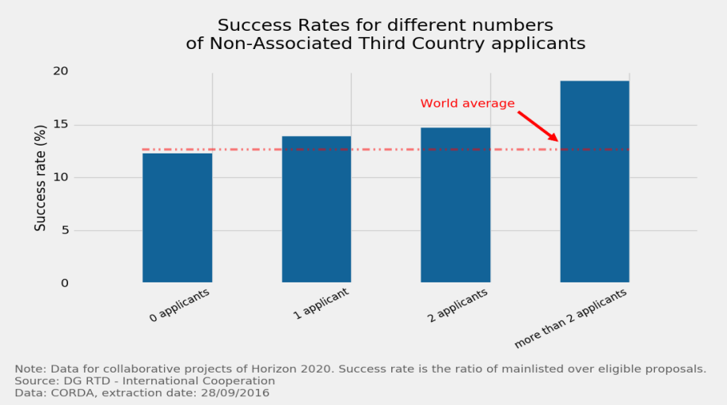
International participation increases H2020 success rate

Slide 15
Funding support from the Russian Ministry of Education & Science (MON): procedure
EU side: Horizon 2020 programme
RU side: Federal Targeted Programme for R&D
Publication of H2020 Work Programmes and calls
Selection of topics prioritised by the Russian Federation (i.e. those for which financial support to the Russian participants can in principle be offered)
Publication of the list of selected calls on the 'Russia's Country Page' of the H2020 Participant Portal
EU coordinator submits a proposal to the EC under the H2020 call
Russian partner(s) of the consortia submit(s) a corresponding proposal to the MON
The EC carries out its standard evaluation procedure of all H2020 project proposals, including those with Russian participants
The MON carries out its standard evaluation procedure of Russian proposals which are part of a submitted H2020 project proposal
Where the EU and MON evaluations overlap, the H2020 project and its Russian part will be funded by, respectively, the EC and the MON according to their funding rules

Slide 16
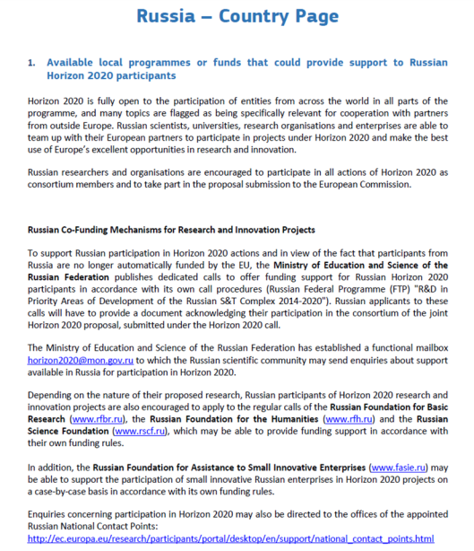
Russia's country page on Horizon 2020 Participant Portal
http://ec.europa.eu/research/participants/data/ref/h2020/other/hi/h2020_localsupp_russia_en.pdf

Slide 17
Horizon 2020 Work Programme 2018 – 2020
Overview
Flagship with Russia initiative in Health
Flagship initiative with Russia in Research Infrastructures
3.1. Russia's involvement in European research infrastructures
3.2. H2020 CREMLIN project
3.3. H2020 "CREMLIN Plus" call (2018-2019)
3.4. H2020 call "Integrating Activities for Advanced Communities"
Multilateral flagship initiative incl. Russia in Aeronautics
Other international cooperation topics
Upcoming calls for Marie Skłodowska-Curie fellowships & European Research Council grants

Slide 18
Horizon 2020 Work Programme 2018 – 2020
Over 60 calls – total budget ~ €30 billion
Focus on:
Market creating innovation - first phase of European Innovation Council (EIC): brings together existing instruments: the SME Instrument, Inducement prizes, FET-Open and 'Fast Track to Innovation'
Political priorities of the European Commission - a low-carbon, climate resilient future (€ 3.3 billion); circular economy (€941 million); digitising and transforming European industry and services (€ 1.7 billion); and security union (€1 billion)
Strengthening international R&I cooperation - 30 flagship initiatives on topics dedicated to international cooperation in areas of mutual benefit, comprising a total budget of over € 1 billion.

Slide 19
Flagship initiatives with Russia (1) - HEALTH
Research on HIV, tuberculosis (TB) and/or hepatitis C (HCV) in patients with mono-, co-infections and/or comorbidities in the context of fostering collaboration with the Russian Federation (Исследования по ВИЧ, туберкулезу и/или гепатиту С у пациентов с моно-, сопутствующими инфекциями и/или сопутствующими заболеваниями в контексте развития сотрудничества с Российской Федерацией):
http://ec.europa.eu/research/participants/portal/desktop/en/opportunities/h2020/topics/sc1-bhc-21-2018.html
Topic identifier: SC1-BHC-21-2018
Type of action: RIA Research and Innovation action
Deadline for proposal submission: 18 April 2018
Planned EU contribution: € 10 million (between € 2 to 3 million per project)

Slide 20
Flagship initiatives with Russia (1) - HEALTH
Proposals should address one or more of the following subtopics:
TB: To investigate biomarkers or new diagnostic tests for early screening of TB risk groups for TB infection and identification of antimicrobial drug resistance.
HIV: To investigate the susceptibility to HIV and/or disease progression rate after infection, including various HIV subtypes and/or transmission clusters, and/or the development of adverse effects during antiretroviral therapy and concomitant diseases (comorbidities and/or co-infections, including with tuberculosis).
HCV: To evaluate the genetic determinants of the virus and the host, and comorbid conditions that can be involved in disease progression and create the basis for the development of future HCV treatment strategies.

Slide 21
Flagship initiatives with Russia (1) - HEALTH
Цели и задачи предполагаемых исследований
Туберкулез: исследование биомаркеров; создание новых диагностических тестов для раннего скрининга социальных групп риска с целью выявления ТБ и множественной лекарственной устойчивости возбудителя.
ВИЧ/СПИД: исследование восприимчивости к ВИЧ и/или скорости прогрессирования заболевания, в том числе и при инфицировании различными подтипами ВИЧ и/или внутри кластеров передачи заболевания; исследование нежелательных явлений при антиретровирусной терапии ВИЧ у больных с коморбидными состояниями и ко-инфекциями, в том числе ТБ и ВГС
Вирусный гепатит С: изучение вклада генетических факторов вируса и его носителя, а также коморбидных состояний, который могут влиять на прогрессирование заболевания; создание научной основы для стратегий лечения ВГС в будущем

Slide 22
Flagship initiatives with Russia (1) - HEALTH
Expected Impact:
Improvement of coordination and integration between European and Russian clinical and research centres dealing with HIV, TB and/or HCV infected patients.
Produce scientific evidence leading in the long-term to the reduction of the burden of these infection diseases.
Produce scientific evidence and contribute to the optimisation (and personalisation) of diagnosis, treatments and improvement of quality of life of patients affected by HCV, HIV and/or TB infections (mono or co-infections) and comorbidities.
Contribute to the achievement of the Sustainable Development Goal 3: Ensure Healthy lives and promote wellbeing for all at all ages, the WHO end TB strategy, the WHO global health sector strategy on HIV , and the WHO global health sector strategy on viral hepatitis.

Slide 23
Flagship initiatives with Russia (1) - HEALTH
Ожидаемые результаты проекта
Эпидемиологические: получение научных результатов, которые в долгосрочной перспективе позволят снизить распространенность инфекционных заболеваний
Стратегические: получение научных результатов и вклад в оптимизацию и персонификацию методов диагностики, лечения и повышения качества жизни больных с ВИЧ, ТБ или ВГС (в виде моно- или ко-инфекций) и коморбидными состояниями
Глобальные: вклад в достижение 3-ей Цели устойчивого развития ООН: Обеспечение здоровой жизни и улучшение благополучия все групп населения всех возрастов, а также вклад в развитие стратегий ВОЗ в области борьбы с ТБ, ВИЧ/СПИД и ВГС.
Организационные: усиление координации и интеграции между российскими и европейскими научными и клиническими группами и институтами, занимающимися вопросами лечения ВИЧ, ТБ и ВГС

Slide 24
Flagship initiatives with Russia (1) - HEALTH
In addition to the minimum number of participants, proposals shall include at least one participant from the Russian Federation.
Also, the duration of the proposed action cannot exceed 24 months (until end of 2020), with a foreseen start of the action no later than 1 January 2019.
For more information, interested entities in the Russian Federation shall consult the website of the Russian NCP for Health at http://www.h2020-health.ru/ru/competition-ru-eu, as well as the website of the Ministry of Education and Science of the Russian Federation http://www.fcpir.ru/participation_in_program/contests/list_of_contests/1_published/2019-14-588-0001/, where the corresponding Russian call has been published.

Slide 25
Russia's involvement in research facilities in Europe: Some examples
X-ray Free-Electron Laser (XFEL) – RU contribution ~€306.4 million (26.79% of the total budget)
Facility for Antiproton and Ion Research (FAIR) – RU contribution ~€ 178.05 million (17.34% of the total budget)
European Synchrotron Radiation Facility (ESRF) – RU contribution ~€ 5.26 million per year (6% of the total annual budget)
European Organisation for Nuclear Research (CERN) – RU contribution ~€ 2.2 million per year + €10 million for LHC modernisation
International Thermonuclear Experimental Reactor (ITER) – RU contribution ~€ 1727.1 million (9.09% of the total budget)

Slide 26



Horizon 2020 "Cremlin" project (01/09/2015 - 31/08/2018) – Connecting Russian and European Measures for Large-scale Research Infrastructures (https://www.cremlin.eu/)
Objective: to foster scientific cooperation between the Russian Federation and the European Union in the development and scientific exploitation of large-scale research infrastructures.
Project coordinator: Deutsches Elektronen-Synchrotron – DESY
Participants: 19 organisations from 6 countries (Belgium, France, Germany, Russia, Sweden, Switzerland)
Participants from Russia:
National Research Centre “Kurchatov Institute”,
Petersburg Nuclear Physics Institute National Research Centre “Kurchatov Institute”,
Joint Institute for Nuclear Research,
Institute of Applied Physics of the Russian Academy of Sciences,
Budker Institute of Nuclear Physics,
Shubnikov Institute of Crystallography.
Total cost: € 1,696,250
EU contribution: € 1,696,250

Slide 27

Horizon 2020 "Cremlin" project
…targets at all 6 Russian megascience projects:
  Powerful Research Reactor PIK, PNPI Gatchina
  Ion Collider Facility NICA, JINR Dubna
  Fourth Generation SR Source SSRS-4, NRC KI Moscow
  High power laser XCELS, IAP Nizhniy Novgorod
  Lepton collider STC, BINP Novosibirsk
  (Fusion project IGNITOR, NRC KI Moscow)
(which are at very different status of implementation. PIK, NICA, IGNITOR: receiving national funding, called "international" megascience projects; SSRS4 funding excpected soon.
…is a 'pathfinding' project
…aims at improving and strengthening the collaboration between Russian and European research infrastructures (RI), and at a better integration of both research areas
The three key objectives for CREMLIN are to:
  Enhance European-Russian science cooperation around the mega science facilities
  Develop recommendations, strategies and perspectives for an enhanced European-Russian cooperation
  Establish an exchange platform for mutual learning across the various science disciplines and communities

Slide 28
Flagship initiatives with Russia (2) - Research Infrastructures
Policy and international cooperation measures for research infrastructures - (c) Research and Innovation actions for the 2019 deadline:
http://ec.europa.eu/research/participants/portal/desktop/en/opportunities/h2020/topics/infrasupp-01-2018-2019.html
Topic identifier: INFRASUPP-01-2018-2019
Type of action: RIA Research and Innovation action
Planned opening date: 14 November 2018
Deadline for proposal submission: 20 March 2019
Planned EU contribution: up to € 25 million

Slide 29
Flagship initiatives with Russia (2) - Research Infrastructures
Proposals will have to demonstrate the involvement of relevant entities on both European and Russian side and will cover the following 3 dimensions:
Support the strengthening of the complementarity between Russian Mega Science initiatives and their European counterparts (joint development and acquisition of specific instrumentation; joint conceptual and technical design; joint development of future technologies required for Research Infrastructures' instrumentation);
Contribute to overcoming the barriers that prevent European scientists from accessing Russian Research Infrastructures of European interest.
Develop a staff exchange programme and thematic courses and workshops (e.g. summer schools), aimed at fostering exchanges of best practices on management practices, access procedures and scientific collaboration between infrastructure Staff and Scientists belonging to both the Russian Federation and European Union.

Slide 30
Flagship initiatives with Russia (2) - Research Infrastructures
Проектные заявки должны будут продемонстрировать участие соответствующих субъектов на европейской и российской стороне и охватить следующие 3 направления:
Поддерживать усиление взаимодополняемости между российскими установками класса Mega Science и их европейскими партнерами (совместная разработка и приобретение специальных приборов, совместное концептуальное и техническое проектирование, совместная разработка будущих технологий, необходимых для развития инструментальной базы исследовательских инфраструктур);
Способствовать преодолению барьеров, препятствующих доступу европейских ученых к российским исследовательским инфраструктурам, представляющим интерес для Европы;
Разработать программу обмена персоналом и тематические курсы и семинары (например, летние школы), направленные на содействие обмену передовым опытом в области практики управления, процедур доступа и научного сотрудничества между персоналом и учеными установок, принадлежащих как Российской Федерации, так и Европейскому Союзу.

Slide 31
Research Infrastructures – additional opportunities
Integrating Activities for Advanced Communities:
http://ec.europa.eu/research/participants/portal/desktop/en/opportunities/h2020/topics/infraia-01-2018-2019.html
Topic identifier: INFRAIA-01-2018-2019
Type of action: RIA Research and Innovation action
Deadline for proposal submission: 22 March 2018
'Advanced Communities' are scientific communities whose research infrastructures show an advanced degree of coordination and networking at present, attained, in particular, through Integrating Activities awarded under FP7 or previous Horizon 2020 calls.
N.B. "Legal entities established in Australia, Brazil, Canada, China, India, Japan, Mexico, New Zealand, Republic of Korea, Russia and USA, which provide, under the grant, access to their research infrastructures to researchers from Members States and Associated countries, are eligible for funding from the Union."

Slide 32
Research Infrastructures – additional opportunities
Цель конкурса: объединение и интеграция ключевых национальных и региональных исследовательских инфраструктур на европейском уровне, их открытость для европейских исследователей из научных центров, университетов и промышленных компаний, обеспечение оптимального совместного использования и развития инфраструктур.
Термин «Advanced Communities» (Продвинутые сообщества) означает сообщества исследователей, инфраструктуры которых демонстрируют высокую степень координации и взаимодействия, что может быть, в частности, результатом совместных проектов 7-ой рамочной программы и первых конкурсов программы «Горизонт 2020».
Проекты предполагают координацию и интеграцию ключевых инфраструктур в конкретной области. Чтобы избежать дублирования, только один проект будет финансироваться в каждой тематической области. Вклад Еврокомиссии в бюджет каждого проекта составит до 10 млн. Евро.
Текущий конкурс охватывает 7 тематических доменов: биология и науки о жизни, энергетика, окружающая среда и науки о Земле, математика и ИКТ, науки о материалах и аналитическое приборостроение, физические науки, социальные и гуманитарные науки.

Slide 33
Flagship initiatives with Russia (3) - Aeronautics
Aviation International Cooperation Flagship "Safer and Greener Aviation in a Smaller World"
Innovative technologies for improving aviation safety and certification in icing conditions (Инновационные технологии для повышения безопасности и сертификации ЛА в условиях обледенения)
http://ec.europa.eu/research/participants/portal/desktop/en/opportunities/h2020/topics/mg-2-5-2018.html
Topic identifier: MG-2-5-2018 Type of action: RIA Research and Innovation action
Deadline for proposal submission: 04 April 2018
Planned EU contribution: € 16 million (between € 3 to 5 million per project)
Направления (1 или более):
Дальнейшие достижения в области обнаружения, понимания, моделирования
и тестирования явления обледенения и защиты от обледенения всех типов (кристаллы льда, переохлажденные крупные капли и др.)
Изучение/предложение/валидация новых методов сертификации, методов оценки соответствия, стандартов и систем защиты (активные или пассивные, включая покрытия, и др.) для всех типов обледенения и ЛА, двигателей и бортовых систем
Рассмотрение комплексной интеграции системы, включая аспекты эксплуатации и ремонта
Ожидаемый результат:
Повышение безопасности пассажиров за счет сокращения числа происшествий
Снижение затрат всех лиц (промышленности, органов власти, исследовательских и испытательных центров) путем совершенствования и принятия на международном уровне сертификации, стандартов и методов оценки соответствия для всех типов угроз обледенения
Снижение задержек полетов благодаря более эффективному предотвращению угрозы обледенения и сокращению количества повреждений ЛА, требующих обследования и ремонта

Slide 34
Flagship initiatives with Russia (3) - Aeronautics
Future propulsion and integration - Towards a hybrid/electric aircraft (Будущие силовые установки и их интеграция: на пути к гибридному/электрическому самолёту):
http://ec.europa.eu/research/participants/portal/desktop/en/opportunities/h2020/topics/lc-mg-1-7-2019.html
Topic identifier: LC-MG-1-7-2019 Type of action: RIA Research and Innovation action
Opening date: 04 December 2018
Deadline for proposal submission: 24 April 2019
Planned EU contribution: € 15 million (between € 3 to 5 million per project)
Направления (1 или более):
Разработка инструментов для комплексной междисциплинарной оценки
реализуемости архитектур гибридных / электрических СУ, включая подробное технико-экономическое обоснование инновационных решений по распределению, использованию и хранению энергии
Изучение технологий аккумулирования энергии для ее использования в полете и/или во время взлета, посадки и руления
Изучение новых технологий хранения энергии, которые могут соответствовать требованиям для гибридных / электрических СУ (эксплуатационные характеристики, безопасность, ...)
Разработка передовых решений устранению электромагнитных помех, а также обеспечение терморегулирования на системном уровне
Ожидаемый результат:
Новый сдвиг парадигмы к авиации без вредных выбросов
Усиление среднесрочной и долгосрочной конкурентоспособности европейской аэронавтики
Создание «дорожной карты» и определение ключевых технологий для полностью электрических или гибридно-электрических ЛА
Подготовка фундамента для разработки демонстраторов следующего поколения

Slide 35
Flagship initiatives with Russia (3) - Aeronautics
Towards a high-speed global air transportation demonstration (На пути к демонстрации высокоскоростной глобальной авиатранспортной системы) – please see the call for proposals 'H2020-MG-2018-2019-2020-continued' in: http://ec.europa.eu/research/participants/data/ref/h2020/wp/2018-2020/main/h2020-wp1820-transport_en.pdf

Slide 36
Flagship initiatives with Russia (3) - Aeronautics
Human Factors in Transport Safety (Человеческий фактор (ЧФ) в области транспортной безопасности): http://ec.europa.eu/research/participants/portal/desktop/en/opportunities/h2020/topics/mg-2-1-2018.html
Topic identifier: MG-2-1-2018 Type of action: RIA Research and Innovation action
Deadline for proposal submission: 1st stage: 30 January 2018, 2nd stage:19 September 2018
Planned EU contribution: € 18 million (between € 4 to 8 million per project)
Направления (подтема В, все):
Улучшение оценки рисков, связанных с ЧФ, при проектировании и эксплуатации ВС, в т.ч. в экстремальных ситуациях (столкновение, попадание в СПП, отклонение от ВПП и пр.)
Определение новых факторов риска в условиях повышения уровня автоматизации
Сбор и анализ данных по происшествиям; создание, поддержание и обновление открытого ресурса таких данными
Разработка методологий по учету рисков, связанных с ЧФ, при оценке безопасности проектирования и эксплуатации ВС
Разработка стандартизированных руководств по оценке и классификации ЧФ при расследовании происшествий
Разработка руководств и рекомендаций по корректировке существующих правил и норм
Ожидаемый результат:
Повышение безопасности транспортной системы благодаря:
своевременному и комплексному учету ЧФ при проектировании и эксплуатации ВС и инфраструктуры
оценке влияния ЧФ при происшествиях, осуществимой благодаря созданию долгосрочного ресурса данных по ЧФ
уменьшения столкновений и инцидентов, связанных с ЧФ, благодаря использованию преимуществ повышения автоматизации при эксплуатации и контроле транспорта

Slide 37
OTHER INTERNATIONAL COOPERATION TOPICS
General information about international cooperation opportunities in Horizon 2020, including a list of topics for international cooperation, can be found at:
http://ec.europa.eu/research/participants/docs/h2020-funding-guide/cross-cutting-issues/international-cooperation_en.htm

Slide 38
MSCA & ERC: open & forthcoming opportunities
MARIE SKŁODOWSKA-CURIE INDIVIDUAL FELLOWSHIPS
http://ec.europa.eu/research/participants/portal/desktop/en/opportunities/h2020/topics/msca-if-2018.html
Opening date: 12 April 2018, Deadline: 12 September 2018
Check for more MSCA & ERC calls at the H2020 Participant Portal

Slide 39
Horizon 2020: benefits of participation
"Участие в Рамочной программе ЕС помогло нашему университету значительно увеличить число совместных публикаций в международных научных журналах…"
world
"We were able to benchmark results of our research activities at the world level…"
"Участие в проектах научной программы ЕС – это международный знак качества, признание высокого уровня проводимых исследований…"
"Thanks to this experience we became part of the world-leading scientific network in our area. It served well to building our international reputation…"
"Благодаря участию в проекте, мы смогли вывести свои технологии и ноу-хау на мировой рынок. Это стало качественным скачком в развитии нашей деятельности…"
"Unsere Teilnahme an dem Projekt des Rahmenprogramms hat uns Zugang zu erstklassigen Daten und Forschungseinrichtungen gegeben..."

Slide 40
Framework Programme 7 statistics*: Russia's participation
Russian entities have participated 694 times in 449 FP7 grant agreements, receiving 81.2 million euros from the EU while 56.5 million euros is the non-EU budget.
Regarding collaborative actions, Russian applicants were involved 2615 times in 1763 eligible proposals, having led to 314 funded projects that involve 523 Russian participations. Russian participants have received 69.5 million euros from EU while 56.5 million euros is the non-EU budget.
Regarding Marie-Curie (MC) actions of FP7, RU entities have participated 170 times in signed MC actions, receiving 11.5 million euros from the European Commission. Also, a total of 1558 researchers of RU nationality have participated in MC actions.
* as of August 2017

Slide 41
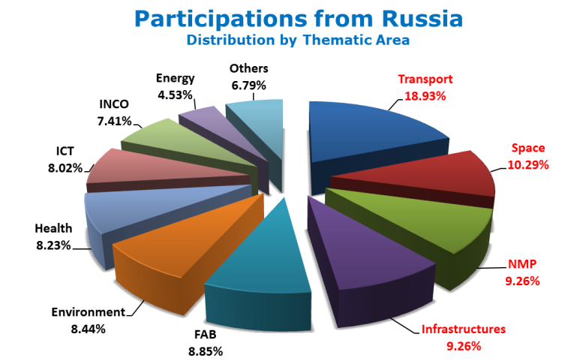
Participation in FP7: key figures

Slide 42
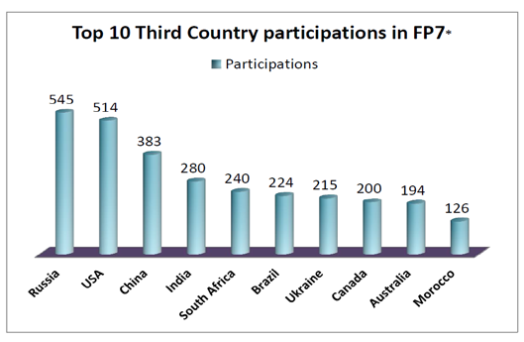
Participation in FP7: key figures

Slide 43
Horizon 2020 statistics*: Russia's participation
Russian entities have participated 81 times in 58 signed grant agreements of collaborative, MSCA and ERC actions of Horizon 2020, receiving 2.5 million euros of direct EU contribution, while 8.5 million euros is the non-EU budget.
Regarding collaborative actions, Russian applicants were involved 216 times in 154 eligible proposals, having led to 37 signed grants that involve 53 Russian participations.
Regarding Marie Sklodowska-Curie Actions (MSCA), RU entities have participated 28 times in signed MSC actions. Also, a total of 163 researchers of RU nationality have participated in MSCA.
Russia's applicant success rate of 27.9% is almost twice as high as the overall success rate in the programme (14.5%).
* as of August 2017

Slide 44
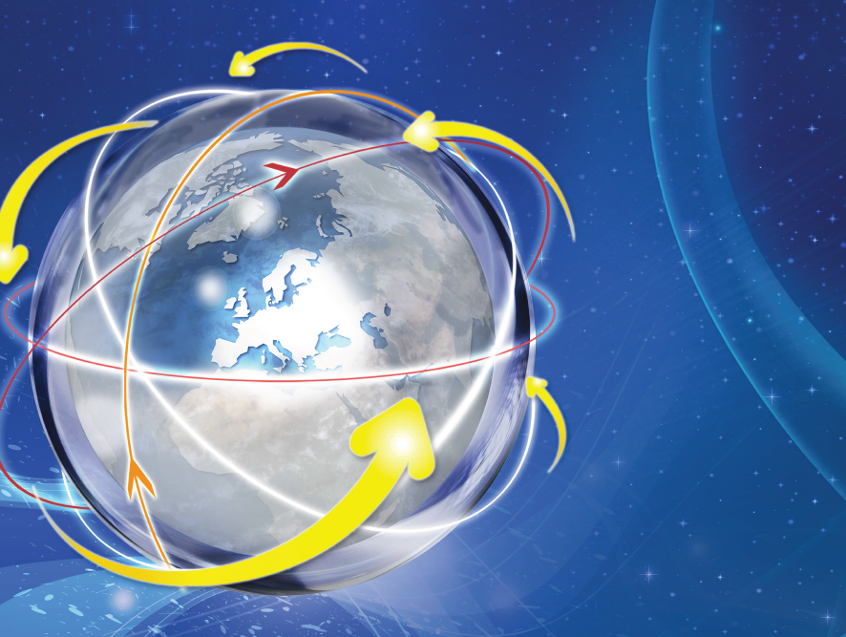
Russian participations in Horizon 2020
(as of May 2017)

Slide 45
ERA-NET instrument
The "ERA-NET instrument" under Horizon 2020 supports public-public partnerships in their preparation, establishment of networking structures, design, implementation and coordination of joint activities as well as topping up of single joint calls and of actions of a transnational nature.
Typically, an ERA-Net brings together national research-funding organisations that wish to implement a joint transnational call for research proposals (for which the EU can provide 'top-up' funding).
From 2004 to 2012, over €2 billion of public funding were spent by different programmes investing jointly in coordinated research across borders.
Funding organisations from "third countries" (such as Russia) can and do participate in ERA-Nets.

Slide 46
Ongoing ERA-NETs with Russian participation
ERA.Net RUS Plus – strengthening STI links between Russia and the European Research Area, RU funding partners: Ministry of Education & Science, RFBR, RFH, Ural and Far Eastern Branches of Russian Academy of Sciences. Foundation for Assistance to Small Innovative Enterprises (FASIE), http://www.eranet-rus.eu/
MANUNET III (ERA-NET on advanced manufacturing technology), RU funding partner: FASIE, http://www.manunet.net/ Call 2018 open – deadline for pre-proposals: 23 March 2018, deadline for full proposals: 12 July 2018
EuroTransBio – ERA-NET in Biotechnology. Russian funding partner: FASIE, https://www.eurotransbio.eu/
EUPHRESCO - European Phytosanitary Research Coordination: Russian partner: All-Russian Plant Quarantine Centre (FGU VNIIKR), https://www.euphresco.net/
IraSME ("International research activities by SMEs"), Russian funding partner: FASIE, http://www.ira-sme.net/ Call 2018 open – deadline for proposals: 28 March 2018
M-era.Net II- an ERA-NET in materials science and engineering: Russian funding partner: FASIE, https://m-era.net/
ERA CoBioTech – an ERA-NET in Biotechnology. RU Funding partner – FASIE, https://www.cobiotech.eu/
BONUS - Baltic Sea Science – Network of Funding Agencies (Art. 185 initiative): RFBR participates in the BONUS calls on the basis of a Memorandum of Cooperation, https://www.bonusportal.org

Slide 47
H2020 call for expressions of interest from experts
Join the database of independent experts for European research and innovation.
The European Commission appoints independent experts to assist with research and innovation assignments including the evaluation of proposals, monitoring of projects, and evaluation of programmes, and design of policy.
Register online at:
http://ec.europa.eu/research/participants/portal/desktop/en/experts/index.html

Slide 48
Towards FP9
Through an on-line consultation, open until 08 March 2018, the European Commission is inviting public input on the EU budget for the successor to the Horizon 2020 programme, covering the single market, small- and medium-sized businesses and other financial assistance programs for stimulating innovation.
The consultation is open to all citizens, organisations and stakeholders with an interest and/or involvement in issues related to investment, entrepreneurship, research, innovation and SMEs. It is accessible in 23 EU languages, and contributions may be submitted in any of the official EU languages.
Link: https://ec.europa.eu/info/consultations/public-consultation-eu-funds-area-investment-research-innovation-smes-and-single-market_en

Slide 49
Useful links
Horizon 2020 official webpage: http://ec.europa.eu/programmes/horizon2020/
Horizon 2020 Participant Portal: http://ec.europa.eu/research/participants/portal/
European Commission – Research & Innovation:
http://ec.europa.eu/research/index.cfm
Delegation of the European Union to the Russian Federation:
http://www.EUinRussia.ru
Science & Technology section:
delegation-russia-science@eeas.europa.eu
Ministry of Education & Science of the Russian Federation (for enquiries about the possibility of funding support): horizon2020@mon.gov.ru
EU-Russia Year of Science 2014:
http://eu-russia-yearofscience.eu , http://godnauki-rossiya-ec.ru
Enterprise Europe Network – Russia:
http://business-russia-een.ru/en/ , http://een.ec.europa.eu/about/branches/RUSSIA

Slide 50
Russian National Contact Points
Smart, green and integrated transport - http://ncp.tsagi.ru/
Nanotechnologies & advanced materials - http://www.ncp-nano.ru/
Information and Communication Technologies - http://www.e-arena.ru
Secure, clean and efficient energy - http://www.fp7-energy.ru
Inclusive, innovative and reflective societies - Science with and for Society - https://fp.hse.ru
Research Infrastructures - http://h2020-infra.misis.ru
SMEs - http://www.fasie.ru
Marie Skłodowska-Curie actions - https://fp.hse.ru
Food security, sustainable agriculture, marine and maritime research and the bio-economy; & Biotechnology - http://bio-economy.ru
Climate action, environment, resource efficiency and raw materials - http://ncp-eco.ru
Health, demographic change and wellbeing - http://www.h2020-health.ru

Slide 51
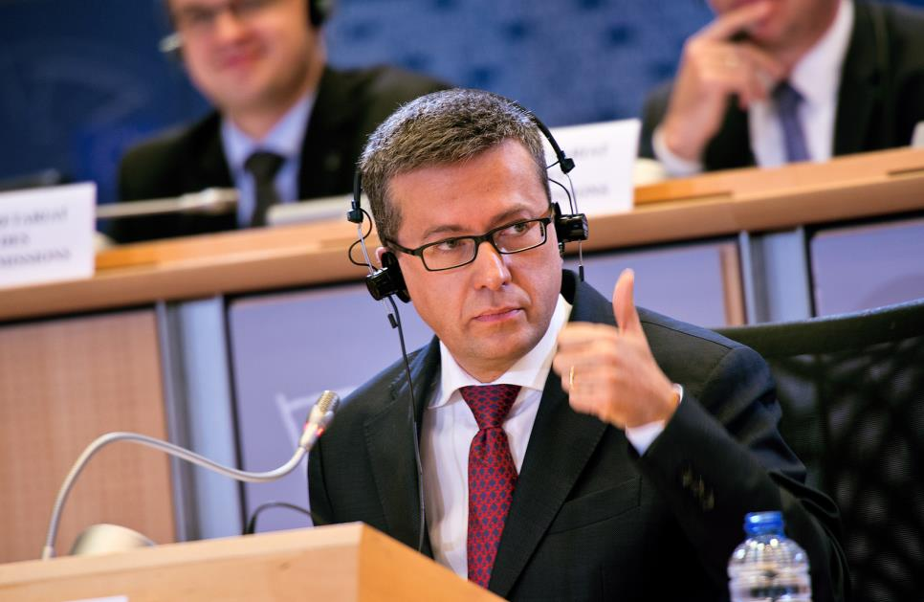
"The European Union has imposed many sanctions on Russia, but one area where we have endeavoured to maintain our strong connection is in the area of research and innovation. Russia is a very active scientific partner of the EU. It is still a welcome partner in Horizon 2020 projects. We are working to maintain this important bridge to Russia, preserving a precious link through the common language and ideals of science."

Slide 52
Thank you for your attention!

