Slide 1
A few words about membrane proteins
Membrane Proteins (MP) are those that have more than one transmembrane segment (TM).
GPCRs, Ion channels and Transporters are usual representatives of MPs.
MPs usually have 2, 3,4, 6, 7 and 12 transmembrane segments. 7 TM proteins are GPCRS. 12 TM membrane proteins are usually transporters. 2,3,4,6 TM proteins usually are ion channels composed of a few similar monomers.
MPs can exists in a stable shape only inside lipid membrane, or, temporality in soft detergents.
Among soft detergents useful for MP purification in a native conformation are: Cymal-5, Dodecylmaltoside, Triton-100, CHAPS, CHAPSO, and Maleic acid, as you have mention.
All MPs have very short extracellular loops, usually around 5-25 amino aicids long. These loops do not retain their native conformation if expressed separately.
Meanwhile, single spanning membrane proteins (all CD molecules, for example) have very big, few hundreds long extracellular domain that has native conformatio and folding independent on membrane existance. These TMs needs the membrane only for anchoring to it. Onviously, you can express grams of this proteins easyly as Fc-fusion proteins, or just with His-tag/

Slide 2
Membrane Proteins: Structure & Application of MSM Technologies
Most often conserved among species: low immunogenicity
Short, constrained loops: Peptide fragments do not retain the conformation
“Umbrellas”: Glycosilation groups
>90%
70% 65% 45%
25% 25% 13% 7% 3%
X
Out
Memb.
In
1TM 2TM 2TM 4TM 7TM 3TM 24TM 2TM 6TM
Single-
Span.
NMDA ASIC Tspan1- GPCRs P2X Nav 1.7 KCN1 TRPV1 Tspan33
Ionotropic Glutamate (NMDA, Kainate, AMPA) (2x2TM) - Doable
Acid sensing, ASIC1-4 (4x 2 TM) - Doable
Tetraspanners, Tspan1-33 (1x 4 TM) - Doable
GPCRs (1x 7 TM) - Doable
P2X receptors (3x 2 TM) - Doable
Voltage gated: Nav, Kv, Cav (1x 24 TM) - Difficult
KCN1-15 (4x 2 TM) - Very difficult
TRPA-TRPV (4x 6 TM) - Most difficult
KCN1-15
TRPA-TRPV

Slide 3
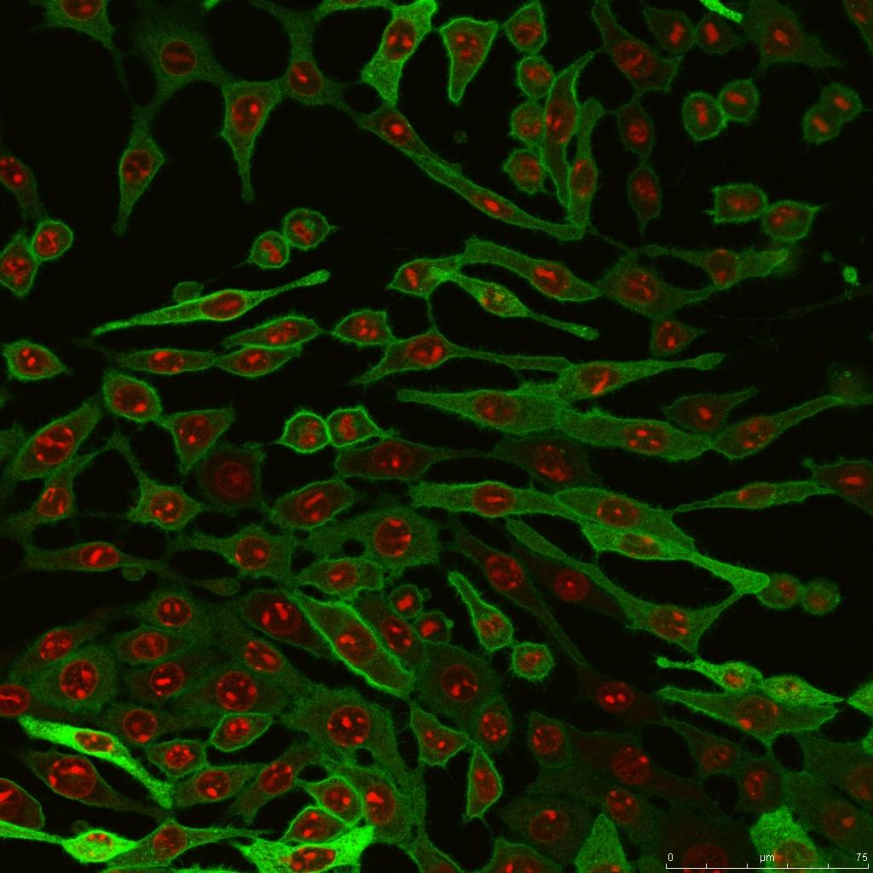
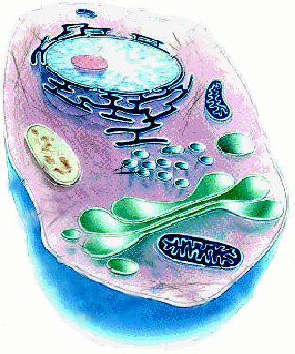
Target Presentation – Magnetic Proteoliposome
MPL Technology – 2 issued international patents
Membrane
1/500 of total protein
Cell
Antigen:
1/10,000
of total
protein
MPL
Essentially
pure antigen
MSM-protein antigen in MPL:
- Native state
- Proper orientation
- Highly purified (>95%)
- Highly concentrated
m
m
S

Slide 4
Advanced Proprietary Antibody Libraries
Complexity: 10¹¹(scFv), 4x10¹⁰ (Fab1), 7x10¹⁰ (Fab2),
6x10¹⁰ (Fab3)
Design: Specifically designed to target GPCRs, ion channels and tetraspanners. Easy affinity maturation.
Validation: Nine GPCRs, several water-soluble targets.
Sub-nanomolar affinities with some targets in
initial screenings (before affinity maturation).
Newer Naïve Patient Library (FabLegionTM):
Naïve, from 10,000 random patients.
Completion expected Q4 2011
m
m
S

Slide 5
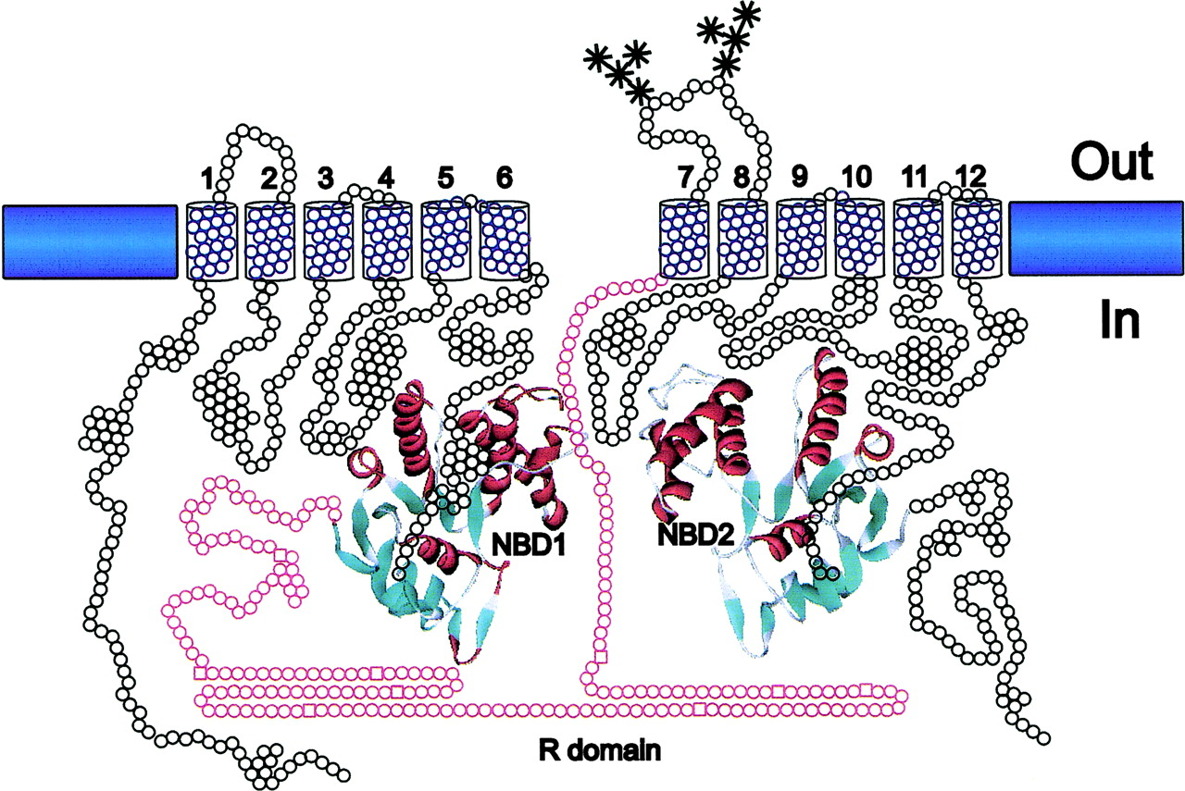
Where is my Epitope? Are there enough amino acids on the surface?
14 5 2 31 2 5
m
m
S

Slide 6
ECLs in GPCRs and Ion Channels
1 2 3
GPCRs
Out
Membrane
In
Ion Channels
1 2 3 4 5 6 7 8 9 10 11 12
Intracellular loops are much longer
m
m
S

Slide 7
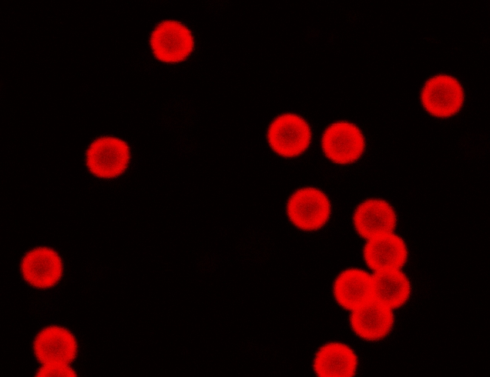
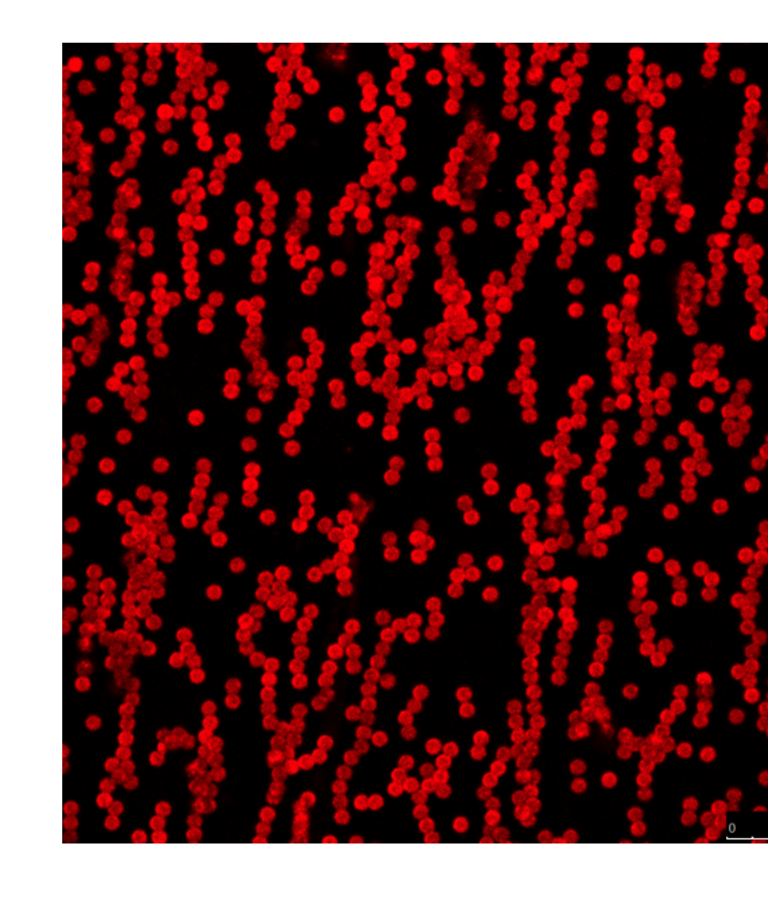
Magnetic Proteoliposomes
with pure, oriented GPCR
Stained with Anti-GPCR IgG-PE
7
7
Notes:
7

Slide 8
Typical Project: 10 Steps
Codon-optimized for GPCR synthetic genes, proprietary expression vectors.
7-10 cell lines over-expressing target GPCR (3-5 human + cyno and rodent orthologs). Cell lines expressing ligands (if applicable)
Cell lines expressing mutated forms based on target polymorphism. Cell lines with alanine scanning of GPCR surface for detailed epitope mapping.
Preparation and characterization of MPL and SIMPL target presentation materials.
Selection of leads from ScFv and/or Fab libraries using propriatary platforms/technologies.
Primary characterization in cell-based assays
Lead selection and affinity maturation
Conversion into desired IgG format (20-30 leads)
Production and detailed cell-based characterization
Scaled up production and collaborative animal studies.

Slide 9
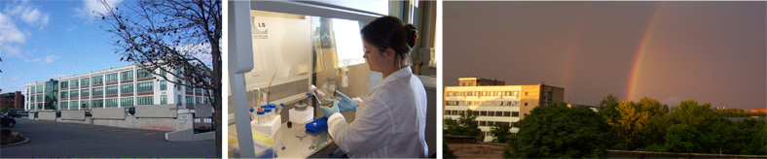
Company Overview:
  World class expertise for the discovery of functional human
  antibodies directed to multi-spanning membrane proteins
  Discovery platform based upon world-class scFv and Fab phage
  libraries and the MPL and SIMPL® presentation of the target.
  Science team: 20 People (18 hold Dr. Sci., Ph.D. or M.S. degree)
  Laboratories: Pushchino, Moscow Region, Russia; fully enabled
  for molecular biology, cell biology, biochemistry, and phage
  display technologies. (Pushchino is a Russian Center for Biomedical
  Studies, an analog of US Bethesda – NIH)
  Established 2006

Slide 10
MAB Drug Discovery Collaborations
 | Partner Company | Year | #, Projects | Status
1. | Cambridge Antibody Technologies (CAT) | 2005 | 2 | Delivered
2. | Astra Zeneca | 2006 | 4 | Delivered
3. | ESBAtech | 2008 | 1 | Delivered
4. | Cystic Fibrosis Therapeutics Found. (CFFT) | 2009 | 1 | Compl., Ph.I
5. | Merck Serono | 2009 | 1 | Delivered
6. | DebioPharm | 2010 | 1 | Delivered
7. | R-Pharm | 2011- | 3 | Ongoing
8. | MinObr/IBP/R-Pharm | 2014-17 | 1 | Ongoing
8. | Generium | 2017 | 1
9. | Biomirex/NIH | 2012-16 | 1 | Delivered
10. | Univ of Saskatoon, McGill Univ (Canada), Case Western Reserve, Biomirex (USA) | 2012-ongoing | 1 | Ongoing

Slide 11
Past Experience/Sucess
Nivolumab (OpdivoTM) – one of the leading blockbuster MAB drugs has been initiated/executed by the team where T.M. worked/headed at Medarex (Bristol-Myers Squibb).
RTH258 (Brolicuzimab) is expected on market in 2018 (Novartis)

Slide 12
Target Presentation: Magnetic ProteoLiposome (MPL)
Membrane
1/500 of total protein
Cell
Antigen:
1/10,000
of total
protein
MPL
Essentially
pure antigen
MSM-protein antigen in MPL:
- In the native state
- In the right orientation
- Pure
- Highly concentrated
12
Notes:
12

Slide 13
Target Presentation: Preparing
Magnetic Proteo-Liposomes (MPL)
Anti-C9 Ab
Streptavidin
Magnetic Bead
Addition of
Cell Lysate
GPCR with
C9-tag
Addition of
Lipids
Lipid
Biotinyl-PE
MPL-GPCR

Slide 14
MPLs Stained
with Anti-GPCR IgG-PE

Slide 15
Proprietary State of the Art scFv and Fab Libraries
Complexity: ~10¹¹(scFv), and ~ 10¹¹ (Fab)
Type: Synthetic, major VH and VK human germline framework.
Design: Specifically designed to target GPCRs, ion channels
and transporters
Easy affinity maturation
Validation: Five major drug target multi-spanners, few water- soluble targets.
Sub-nanomolar affinities with few targets in initial screenings (before affinity maturation).
Cross-reactivity – Human-cyno-mouse cross-reactive MABs have been selected for a few targets

Slide 16
Principal Antibody Libraries in Pharma Industry
# | Company | Library Format | Repertoire | Affinities, Primary, Kd (M) ^{a)} | Affinities, Maturated, Kd (M) ^{a)}
1 | Genentech, (Roche) | Synthetic, Fab | 10¹¹ | 10⁻⁸-10⁻¹⁰, Ref [1,2] | 10⁻¹⁰-10⁻¹¹, Ref [1]
2 | GSK, (Domantis) | Synthetic, VH | >10¹⁰ | unknown | unknown
3 | AstraZeneca (CAT) | Natural, ScFv | 10¹¹ | 10⁻⁷-10⁻⁹ | 10⁻⁹-10^{-11,} Ref [3]
4 | Morphosys (Novartis) | Synthetic, Fab | >10¹⁰ | 10⁻⁸-10⁻¹⁰ Ref [4] | 10⁻¹⁰-10⁻¹² Ref [3]
5 | Dyax | Semisynthetic, Fab | ~10¹¹ | 10⁻⁷-10⁻¹⁰, Ref[5] | unknown
6 | Ely Lilly (ImClone) | Natural, Fab | >10¹⁰ | 10⁻⁷-10⁻⁸ | 10⁻⁹-10⁻¹⁰ Ref [6]
7 | BioInvent | Semisynthetic, scFv | >10⁹ | 10⁻⁶-10⁻⁹ | unknown
8 | Merck | Synthetic, Fab | 10¹⁰ | 10⁻⁷-10⁻¹⁰, Ref[7]
9 | Pfizer (Rinat) | Native, scFv, Ref[7] | 4x10¹⁰ | unknown | unknown
10 | MEPROTEK | Synthetic, scFv Synthetic, Fab | 10¹¹ 10¹¹ | 10⁻⁷-10⁻⁹ 10⁻⁷-10⁻⁹ (membrane Targets) | 10⁻⁷-10⁻⁹ 10⁻⁸-10⁻¹⁰
1.Lee C. et al J.Mol.Biol. 2004, v.340, p.1073-93. 5.HoetR. et al Nature Biotech. 2005, v.23, p.344-348
2.FellouseF. et al J.Mol.Biol. 2007, v.373, p.924-40 6.Lu D. et al J.Biol.Chem. 2003, v.278, p.43496-43507 a) Affinities of monovalent fragments
3.PEGS-2007, May 14-18, 2007, Boston, USA 7.PEGS-2007, May 14-18, 2007, Boston, USA
4.Rothe C et al J.Mol.Biol. 2008, v.376, p.1182-1200 8.PEGS-2007, May 14-18, 2007, Boston, USA

Slide 17
Deliverables:
(Therapeutic Candidate Profile-TCP)
Fully human MABs
3-5 IgGs of necessary format (scFv, Fab, IgG1, IgG4)
Compete and antagonize the binding of natural ligand(s)
High affinity (1nM or less, usually in pM range)
Cross-reactive with cynomolgus ortholog of a target is
an absolute requirement. Cross-reactivity with mouse (or other rodent) orgtholog is desirable.
Highly selective and specific (the preclinical drug candidates are screened against a panel of at least 30-50 different human GPCRs from the Meprotek GPCR Cell Bank)

Slide 18
# | Project | Indications | State | Market World | Market World
1 | C-Reactive Protein (CRP) | Marker of acute inflammation, liver failure, heart attack, severe viral and bacterial infections, internal bleeding. | Marketed | $1.3 M | $200 M
2 | Ferritin | Serum ferritin is measured as diagnostics for anemia, restless legs syndrome. | Developed. Подгатавлив. реистрация с МинЗдравом России | $0.5 M | $80-100M
3 | Procalcitonin (PCT) | Severe sepsis caused by bacteria, grades well with degree of sepsis. PCT differentiate systematic inflammation from sepsis. | Developed. Подгатавлив. реистрация с МинЗдравом России |  | $250 M
4 | Rheumatoid Factor (RF) | Rheumatoid arthritis disease diagnosis and prognosis. RF also serves as one of several serological markers for autoimmunity. | Developed. Подгатавлив. реистрация с МинЗдравом России | $1.3 M | $35 M
5 | Streptolysin (ASLO) | Streptococcal infection. Immunoturbidimetry diafgnostics is ready. | Developed. Подгатавлив. реистрация с МинЗдравом России | $1.5 M | $200 M
6 | Troponin I | Specific indicator of myocardium damage. Epitope 4C7 MAB is broadly used: |  | $3.5 M | $150 M
7 | D-Dimer | Тhrombosis |  |  | $100 M

Slide 19
Meprotek – Summary
Validated platform technology: World-class Fab and scFv Libraries and unique MPL and SIMPL® presentations for GPCRs and other complex membrane proteins.
Western-trained/connected team and fully equipped labs in Pushchino, Russia.
We deliver functional fully human monoclonal antibodies targeting GPCRs at the level of lead drug candidates.
Successful antibody drug development partnerships with leading world biologics companies.
19

Slide 20

Miranta
Diagnostics
Meeting, November 21, 2016
Update & Planning
ooo “Miranta Diagnostics”
7 Institutskaya street, Pushchino, Moscow Region, Russia 142290
20
20

Slide 21
Programs
Ongoing
1. C-Reactive Protein (CRP)
2. Ferritin
  Procalcitonin (PCT)
  Rheumatoid Factors (RF)
  Galectin 3 (Gal-3)
  Planned
Vitamin D
Streptolysin (ST)
3. Creatine Kinase (PCK)???

Slide 22
C-Reactive Protein
STATE:
Antibodies R1, R2 and R3 are ready in MAB and scFv (-DARPin) formats.
Stable cell lines pools are generated for all 3 MABs.
Monoclonal stable cell lines are obtained for all 3 MABs.
MABs are produced, storage conditions are found.
We are able to produce the CRP MABs in commercial amounts (10-50 g/year)
The bead coupling conditions and commercial production of immunoturbidity batches is planned for the first quarter of 2017.
QUESTIONS:
a. Can we sell any anti-CRP MABs
b. Is there any guarantee that MD can sell any CRP immunoturbidity (bead) material if QC is fine?
c. When should we start the work on MinZdrav registration?
FUNDING:
a. “Prioritet” : for the year of 2016 we received 3M rub of external (ПРИОРИТЕТ) money and invested 3M rub our own money (1.5 M – T.M. and 1.5M – A. Sh.)
b. By 21 st of November 2016 we should decide on the last, 3d year of the program. For 2017 Prioritet will give 5M rub, IF we (TM and ASh) co-invest 2.5 M each, in 2 tranches. So far we have filed all the reports/work is done like we are going to request these 2017 funding for 5M rub.

Slide 23
CRP: Cloned stable cell line-based MAB production
R1: Total 26 clones. Of total 6 clones checked one clone produces………… 520 mg/l
R2: Most recently obtained stable cell line. Total 22 clones. Checked 3.
R2 #1 ………….. 8 mg/l
R2 #2 ………….. 17 mg/l
R2#3……………..25 mg/l
R3: Total we have 30 clones. Total 5 clones were checked, the best ………150 mg/l
We also have some leftovers from previous MAB expressions:
Thus, we have on hands enough MAB material for bead conjugation optimization:
R1 = 150 mg,
R2 =
R3 =
On R1,R2, R3 scFv-DARPins cosntructs: the proteins can be easily made from E.Coli clones we have generated. But first we want to optimize immunoturbidity with MABs.

Slide 24
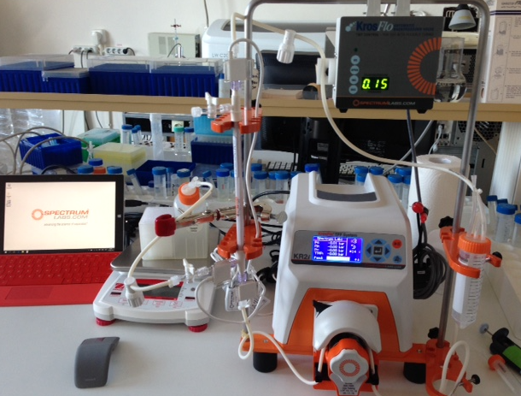
Bead conjugation
The tangential dialysis system KRi-II is
functional now. The current smallest column
we have purchased is not small enough and
Rashid is working on how to optimize small
batches conjugations. First samples were
obtained, and the process is ongoing.
ABCAN is asking almost $500 for analytical
column for dialysis that would help us, but at
the production site it costs $75-100. I might
bring it with me on ~ Jan 5, ‘17.
We have received the ordered 3 tubes of
beads from Bangs Labs, total 15 mls. We also have enough EDC
Thus, all materials necessary for the work (excluding analytical column) is ongoing.
The help of Vasily Travkin and Gleb are appreciated.
Can Vasily work more with us?

Slide 25
Ferritin
STATE:
1. 3 MABs are produced. They were screened for immunoturbidity in the past but did not work. (But that time the CRP MABs did not work as well). With new Spectrolab system available and knowledge accumulated these 3 MABs will be re-evaluated for immunoturbidity.
2. 3 more new MABs are discovered and waiting for conversion from FAB format into MAB format
QUESTIONS:
a. Can we sell any anti-ferritin MABs?
b. Is there any guarantee that MD can sell any CRP immunoturbidity (bead) material if QC is fine?
c. When should we start the work on MinZdrav registration?
FUNDING:
a. “Prioritet” : for the year of 2016 we received 3M rub of external (Prioritet) money and invested 3M rub our own money (1.5 M – T.M. and 1.5M – A. Sh.)
b. By 21 st of November 2016 we should decide on the last, 3d year of the program. For 2017 Prioritet will give 5M rub, IF we (TM and ASh) co-invest 2.5 M each, in 2 tranches. So far we have filed all the reports/work is done like we are going to request these 2017 funding for 5M rub.

Slide 26
Procalcitonin
STATE:
1. The program is initiated in June 2016. All the molecular biology, expression/ purification work is finished.
QUESTIONS:
a. Can we engineer very high affinity, high stability, immunoturbidity-applicable MABs?
b. Will DiaSys purchase the anti-PCT MABs?
c. What is the capacity of Diakon/Russia for PCT immunoturbidity product?
d. When should we start the work on MinZdrav registration?
FUNDING:
a. Internal savings.
b. We are working with Skolkovo & FASIE on 5M rub/2 year funding program and have passed the first round of approval. No co-investment is needed. MD will own all the rights on the product. Upon best scenario these funds will be available by April-May 2017.

Slide 27
Rhеumatoid Factors (RF)
Rheumatoid Factors (RF) cause agglutination of the latex particles coated with human IgG (heat inactivated). The agglutination of the IgG-conjugated latex beads is proportional to the RF concentration in the blood serum and can be measured by turbidimetry.
STATE:
1. The program has been initiated in the spring of 2016 by Inna Solyanikova. Human IgG is obtained in Apteka, heat inactivated.
2. The assay currently on hold untill the installation/first production scale of diagnostics kit for CRP. Alternatively, if we will have problems with anti-CRP MABs or assay in whole, RF assay can be the first we will install.
QUESTIONS:
a. What is the “Calibrator” (Standard): Human serum. RF concentration is stated on the vial label. Concentration value is traceble to the WHO Reference Material W1066 (International Laboratory for Biological Standards, Amsterdam).
b. Can we get a commercial kit from Diakon?
c. Can we sell the kit if successfully established? What is the capacity (kits/year)?
d. When should we start the work on MinZdrav registration?
FUNDING:
a. None. Internal savings.

Slide 28
Streptolysin – O (SLO)
Streptolysin is a streptococcal hemolytic exotoxin. Types include streptolysin O (SLO), which is oxygen-labile, and streptolysin S (SLS), which is oxygen-stable. An antibody, antistreptolysin O, can be detected in an antistreptolysin O titre. The latex particles coated with SLO are agglutinated when they react with serum containing specific antibodies anti-streptolisyn O (ASO). The latex particles agglutination is proportional to the concentration of the ASO in the sample and can be measured by turbidimetry.
STATE:
1. The protocols for generation of E.Coli clones producing the native protein in the range of ~100 mg/ml are reported and we can easily install that production system. The protein is expressed in cytoplasmic form, soluble and correctly folded. Purification through His-6 tag.
2. Anna Shepilyakovskaya already has
QUESTIONS:
a. What is the “Calibrator” (Standard): Human serum. ASO concentration is given on the label. Concentration value is traceable to the Biological Reference Material 97/662 (National Institute for Biological Standards and Control, United Kingdom).
b. Can we get a commercial kit from Diakon?
c. Can we sell the kit if successfully established? What is the capacity (kits/year)?
d. When should we start the work on MinZdrav registration?
FUNDING:
a. None. Internal savings.

