Slide 1

Participation of Russian organisations in H2020: project examples

Slide 2



EVAg (2015-04-01 to 2019-03-31) - European
Virus Archive goes global
Objective: to create and mobilise an International network of high calibre centres around a strong European group of institutes selected for their appropriate expertises, to collect, amplify, characterise, standardise, authenticate, distribute and track, mammalian and other exotic viruses.
Project coordinator: UNIVERSITE D'AIX MARSEILLE
Participants: 25 organisations from 14 countries (France, Germany, United Kingdom, Switzerland, Slovenia, Slovakia, Italy, Netherlands, France, South Africa, Russia, China, Australia, Sweden)
Participants from Russia:
Chumakov Institute of Poliomyelitis and Viral Encephalitides,
Scientific Research Institute of Influenza of The Ministry of Healthcare and Social Development of the Russian Federation,
Research Institute of Vaccines and Sera II Mechnikov.
Total cost: €12,168,054
EU contribution: €10,792,868
Research field: Health

Slide 3


PROTECT (2017-01-01 to 2020-12-31) - Pre-commercial lines for production of surface nanostructured antimicrobial and anti-biofilm textiles, medical devices and water treatment membranes
  Objective: to introduce to the market One step antimicrobial finish processes for polymeric materials used in i) specialty textiles for public areas and hospitals, ii) water treatment membranes, and iii) implantable medical devices
  Project Coordinator: UNIVERSITAT POLITECNICA DE CATALUNYA (Spain)
  Participants: 22 organisations from 8 countries (Spain, Germany, France, Russia, Portugal, Israel, Italy, Ireland)
  Participant from Russia: SYNTHAUR OOO
  Total cost: €9,441,862.50
  EU contribution: €7,478,985

Slide 4
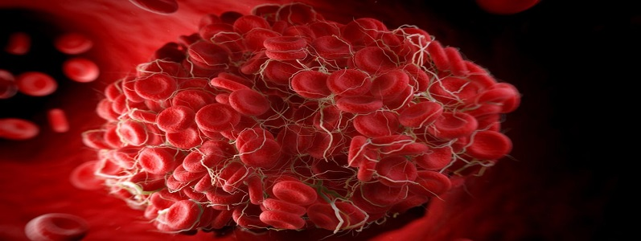

INSIST (2017-11-01 to 2021-10-31) –
IN-Silico trials for treatment of acute Ischemic Stroke
Objective: The main goal of INSIST is to realize in silico clinical stroke trials for biomedical products for treatment of acute ischemic stroke. Such an in silico clinical ischemic stroke trial consists of the generation of populations of virtual stroke patients, in silico models of treatments, and in silico models of the biophysiological aspects of the human response to stroke.
Project coordinator: Academisch Medisch Centrum bij de Universiteit van Amsterdam (Netherlands)
Participants: 11 organisations from 8 countries (United Kingdom, Italy, Russia, Netherlands, Belgium, Ireland, France, Switzerland)
Participant from Russia:
M.V. Lomonosov Moscow State University

Slide 5
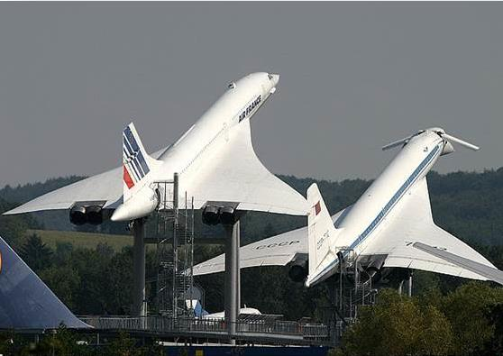
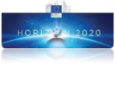

RUMBLE (Nov. 2017 to Oct. 2020) - RegUlation and norM for low sonic Boom LEvels
Objective: Producing the scientific evidence requested by national, European and international regulation authorities to determine the acceptable level of overland sonic booms and the appropriate ways to comply with it. The technical fields investigated by RUMBLE will be: sonic boom prediction capabilities, human response to sonic boom including the effects on sleep disturbance, flight procedures and instrumentation specifications. Flight tests will be performed using existing supersonic aircraft.
Project coordinator: Airbus Group Innovations
Participants: 13 European partners - 6 Russian partners
Budget: €13 Million
Funded by the European Commission and the Russian Federation
With the participation of EASA and DGAC France

Slide 6

ARTEM ( Dec. 2017 to Nov. 2021) –
Aircraft noise Reduction Technologies and
related Environmental iMpact
Objective: the development of innovative technologies for the reduction of aircraft noise at the source
Project coordinator: DEUTSCHES ZENTRUM FUER LUFT - UND RAUMFAHRT EV
Participants: 24 organisations from 10 countries (Germany, Switzerland, France, Italy, Romania, the Netherlands, Slovenia, United Kingdom, Russia, Belgium)
Participant from Russia: Zhukovsky Central AeroHydrodynamic Institute (TsAGI)
Total cost: €7,923,742.50
EU contribution: € 7,498,742.50

Slide 7
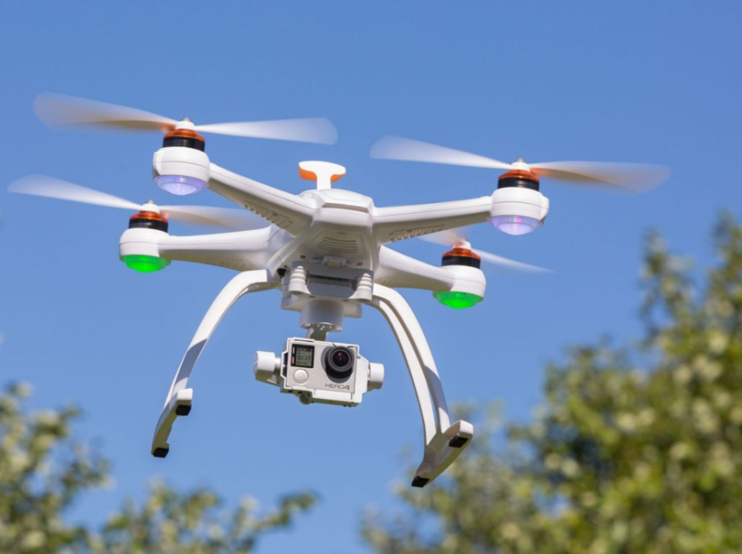
AIRPASS (Nov. 2017 to Oct. 2019) - Advanced Integrated RPAS Avionics Safety Suite
Objective: The project addresses the on-board technologies for drones that are required in order to implement the Unmanned Traffic Management (UTM) concept for drone operations at Very Low Level (VLL) and within the Visual Flight Rules (VFR) environment. The project will cover Detect And Avoid (D&A) systems for cooperative and non-cooperative traffic, auto-pilot systems as well as Communication, Navigation and Surveillance (CNS) systems.
Project coordinator: DEUTSCHES ZENTRUM FUER LUFT - UND RAUMFAHRT EV
Participants: 8 organisations from 6 countries (Germany, Israel, the Netherlands, Italy , Sweden, Russia)
Participant from Russia: Zhukovsky Central AeroHydrodynamic Institute (TsAGI)
Total cost: €1,264,973.75
EU contribution: €986,223.75

Slide 8
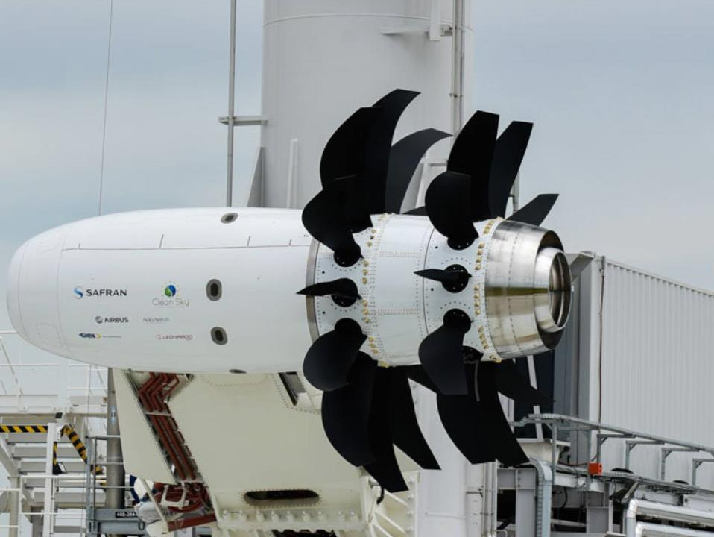
ASPIRE (Jan. 2016 to Sep. 2018) – Aerodynamic and acouStic for high-by-Pass ratIo tuRbofan intEgration
  Objective: to improve and validate numerical and experimental capabilities to assess the aerodynamic and acoustic performance of innovative aircraft configurations equipped with ultra-high by-pass ratio turbofan
  Project Coordinator: OFFICE NATIONAL D'ETUDES ET DE RECHERCHES AEROSPATIALES
  Participants: 4 organisations from 4 countries (France, Germany,the Netherlands, Russia)
  Participant from Russia: Zhukovsky Central AeroHydrodynamic Institute (TsAGI)
  Total cost: €3,406,735
  EU contribution: €2,908,234

Slide 9


Future Sky Safety (Jan. 2015 to Dec. 2018)
Objectives: Coordination of institutional safety research programmes and collaborative safety research
Project coordinator: STICHTING NATIONAAL LUCHT- EN RUIMTEVAARTLABORATORIUM
Participants: 33 organisations from 14 countries (the Netherlands, Germany, France, Portugal, Italy, Switzerland, Romania, Spain, Czech Republic, Sweden, Belgium, United Kingdom, Russia, Ireland)
Participant from Russia: Zhukovsky Central AeroHydrodynamic Institute (TsAGI)
Total cost: €16,382,874.25
EU contribution: €14,882,894

Slide 10
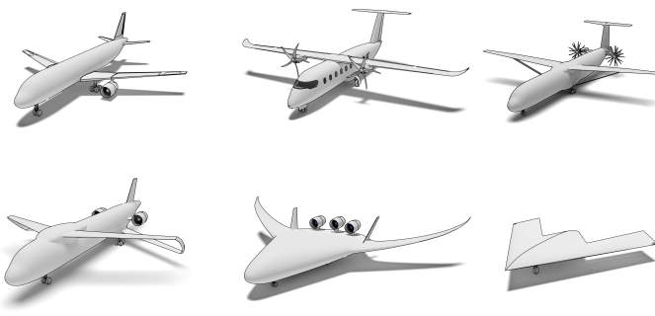

AGILE (June 2015 to May 2018) – Aircraft 3rd Generation MDO for Innovative Collaboration of Heterogeneous Teams of Experts
Objectives: the development and dissemination of knowledge and skills which are required to exploit the potential that latest IT technologies in the field of collaborative design and MDO offer
Project coordinator: DEUTSCHES ZENTRUM FUER LUFT - UND RAUMFAHRT EV
Participants: 20 organisations from 9 countries (Germany, Italy, Canada, Switzerland, Russia, the Netherlands, Belgium, France, Sweden)
Participants from Russia: Zhukovsky Central AeroHydrodynamic Institute (TsAGI), Baranov Central Institute of Aviation Motors (CIAM)
Total cost: €8,965,932.29
EU contribution: €7,074,806.66

Slide 11
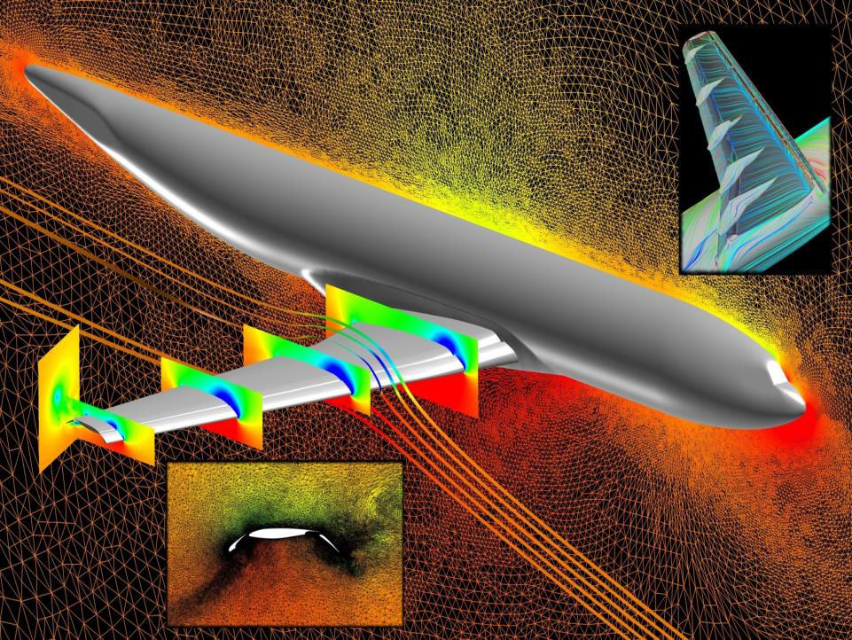

TILDA (May2015 to April 2018) – Towards
Industrial LES/DNS in Aeronautics – Paving the
Way for Future Accurate CFD
Objectives: to offer methods and approaches combining advanced and efficient high-order numerical schemes with innovative approaches for LES and DNS in order to resolve all relevant flow features on tens of thousands of processors in order to get close to a full LES/DNS solution for 1billion degrees-of-freedom (DOF) not exceeding turn-around times of a few days.
Project coordinator: NUMERICAL MECHANICS APPLICATIONS INTERNATIONAL SA
Participants: 11 organisations from 6 countries (Belgium, Germany, France, Italy, United Kingdom, Russia)
Participant from Russia: Zhukovsky Central AeroHydrodynamic Institute (TsAGI)
Total cost: €3,048,742.50
EU contribution: €2,706,241.75

Slide 12


HoNESt (2015-09-01 to 2018-08-31) - History of Nuclear Energy and Society
  Objective: to conduct a three-year interdisciplinary analysis of the experience of nuclear developments and its relationship to contemporary society with the aim of improving the understanding of the dynamics of nuclear sector-society relationship over the last 60 years.
  Project Coordinator: UNIVERSIDAD POMPEU FABRA (Spain)
  Participants: 24 organisations from 16 countries (Spain, Finland, United Kingdom, Germany, Denmark, Belgium, Sweden, United Kingdom, France, Greece, Lithuania, Netherlands, Bulgaria, Russia, Portugal, United States)
  Participant from Russia: Institute of History and Archaeology, the Ural Branch of the Russian Academy of Sciences
  Total cost: €3,052,269
  EU contribution: €3,052,269
  Research Field: Nuclear - EURATOM

Slide 13


INTERACT (2016-10-01 to 2020-09-30) –
International Network for Terrestrial Research and Monitoring in the Arctic
Objective: Aims for a geographically comprehensive & excellent state-of-the-art terrestrial research infrastructure throughout the Arctic and adjoining forest and alpine regions to identify environmental change, to facilitate understanding and prediction of future change and to inform decision makers about societally-relevant impacts.
Project coordinator: LUNDS UNIVERSITET
Participants: 46 organisations from 17 countries (Sweden, United Kingdom, Denmark, Finland, Italy, Germany, Norway, Russia, Czech Republic, Greenland, Poland, Austria, Faeroe Islands, Iceland, Canada, Netherlands, Belgium)
Participants from Russia:
Tomsk State University,
Institute for Biological Problems of Cryolithozone,
M.V. Lomonosov Moscow State University
Yugra State University
Total cost: €10,000,000
EU contribution: €10,000,000

Slide 14


Cremlin (2015-09-01 to 2018-08-31) –
Connecting Russian and European Measures for
Large-scale Research Infrastructures
Objective: to foster scientific cooperation between the Russian Federation and the European Union in the development and scientific exploitation of large-scale research infrastructures.
Project coordinator: Deutsches Elektronen-Synchrotron – DESY
Participants: 19 organisations from 6 countries (Belgium, France, Germany, Russia, Sweden, Switzerland)
Participants from Russia:
National Research Centre “Kurchatov Institute”,
Petersburg Nuclear Physics Institute National Research Centre “Kurchatov Institute”,
Joint Institute for Nuclear Research,
Institute of Applied Physics of the Russian Academy of Sciences,
Budker Institute of Nuclear Physics,
Shubnikov Institute of Crystallography.
Total cost: €1,696,250
EU contribution: €1,696,250

