Slide 1
HORIZON 2020
Excellent Science
Global Challenges
Competitive Industries
Managing Intellectual Property

Slide 2
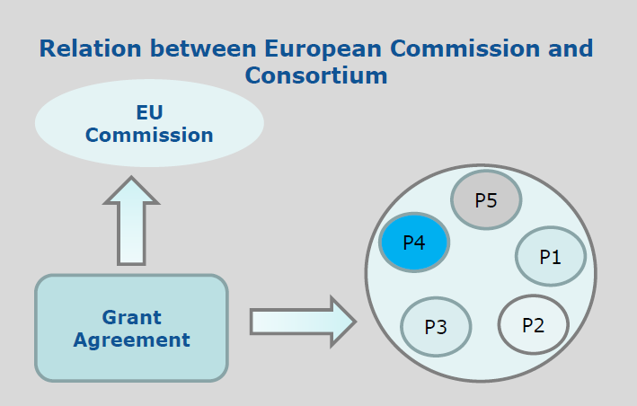
Grant Agreement (GA)

Slide 3
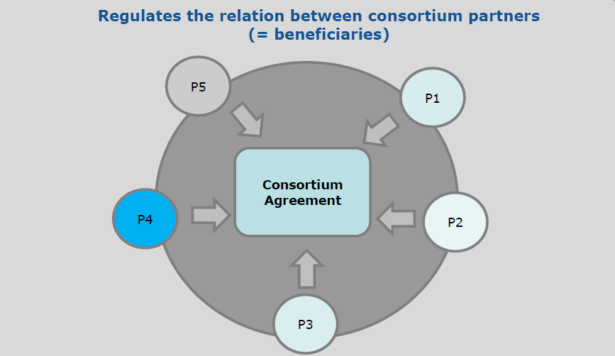
Consortium Agreement (CA)

Slide 4
Intellectual Property rules
The IP rules in Horizon 2020 can be found in:
(i) the Rules for Participation
(ii) the (model) Grant Agreement
(iii) the applicable Work Programme
(iv) H2020 Online Manual
How to find them: Participant Portal –
http://ec.europa.eu/research/participants/portal/desktop/en/home.html

Slide 5
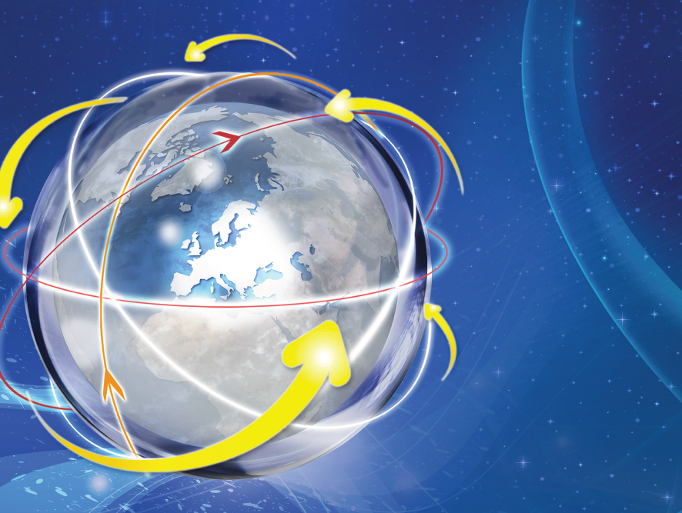
Definitions (I)
Background
Tangible or intangible input (data, knowhow, information) which is held by the project partners prior to their accession to the GA. Includes IP as copyright, patents/ patent applications (filed prior to access to GA).
Examples: prototypes; cell lines; database rights, licences with the right to sublicense
Project partners must identify their background in writing
Best practice: do so before the Grant Agreement is signed!
Results
All results which are generated under the project – whether or not protectable. Such results may include copyrights, design or patent rights, trademarks or others, and belong to the partners who have generated them.

Slide 6
Definitions (II)
Access rights
User rights (incl. licences) to results or background of project partners.
Exploitation
Utilisation (direct/indirect) of results in research activities, which are not part of the project, as well as utilisation for further development, creation and marketing of a product or process.
Dissemination
Means trough which research results are presented to the public. Official publications (e.g. patent applications) are not considered as dissemination.

Slide 7
Access Rights (I)
Each project participant has the right to request access rights to the other project participants‘s background and results as long as it needs them in order to carry out its work under the project or to use its own results (these are minimum access rights).
Shall be requested in writing. Can be granted in any form.
Best practice: to avoid misunderstandings, it is recommended that project partners agree (e.g. in the consortium agreement) on a common interpretation of what is “needed”.
Are to be requested/granted throughout the duration and up to 1 year (or as otherwise agreed in the CA) after the end of the project for exploitation needs. Once requested, access rights may be exercised as long as they are needed for exploiting the results (e.g. until the background patent expires).
Access rights do not confer the right to grant sub-licences!

Slide 8
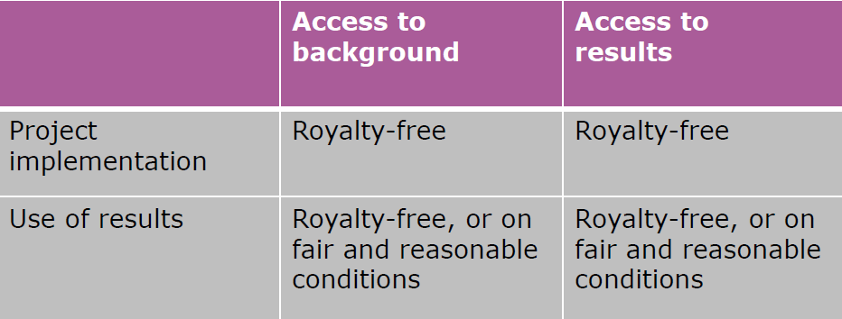
Access Rights (II)
Granting of Access Rights

Slide 9
Exploitation and Dissemination Plan
Project participants have an obligation to define the expected results and their strategy for exploitation and dissemination.
Hence the following information must be included:
A list of expected results that might be exploited (i.e. with commercial or industrial applicability) including their:
  description
  sector of application, and
  protection measures
A list of all the means through which they intend to make the results public knowledge
The potential / expected impact – quantifiable – in terms of marketability and research advancement

Slide 10
Reminder: clarify the ownership of results!
Ownership rules can be found in the GA (default regime) and in the CA.
Principle = results belong to the project partner generating them
Joint ownership:
only if partners have jointly generated results and it is impossible to determine the respective share of the work or to separate them for protection
unless otherwise agreed, each joint owner may grant nonexclusive licences to third parties, without the right to sublicense, if the other joint owners are given:
  prior notice, and
  fair and reasonable compensation
  GA = default joint ownership regime
Best practice: agree on a tailored joint ownership agreement adapted to each jointly owned result.
It is always advisable to clarify the ownership of results within the consortium once they have been created, in line with your CA, before the partners start setting up exploitation strategies!

Slide 11
General obligation to protect
Each project participant must examine the possibility of protecting its results and must adequately protect them — for an appropriate period and with appropriate territorial coverage — if:
(a) the results can reasonably be expected to be commercially or industrially exploited and
(b) protecting them is possible, reasonable and justified (given the circumstances).
When deciding on protection, the project partner must consider its own interests and the interests (especially commercial) of the other project partners.

Slide 12
Obligation to disseminate
Project participants are obliged to disseminate the results swiftly (i.e. to scientific community/broader public) by any appropriate means other than that resulting from the formalities for protecting it or exploiting the results, and including the publication of results in any medium.
But:
no dissemination of results may take place before decision is made regarding their possible protection, and
all patent applications and publications or any other type of dissemination (also in electronic form) shall include a statement that the action received financial support from the European Union – The same applies to results incorporated in standardisation activities.

Slide 13
Open Access (I)
OA = online access at no charge to the end-user (plus further distribution and proper archiving). In H2020:
  General rule = OA to peer-reviewed scientific publications.
  Open Research Data Pilot – optional. May be required in certain areas.
However, open access:
is not an obligation to publish: only if publishing is the chosen dissemination route
does not interfere with the decision to exploit research results commercially e.g. patenting: discussion on open access comes after the decision to protect
publications are not of a lower quality: they go through the same peer review process as other publications

Slide 14
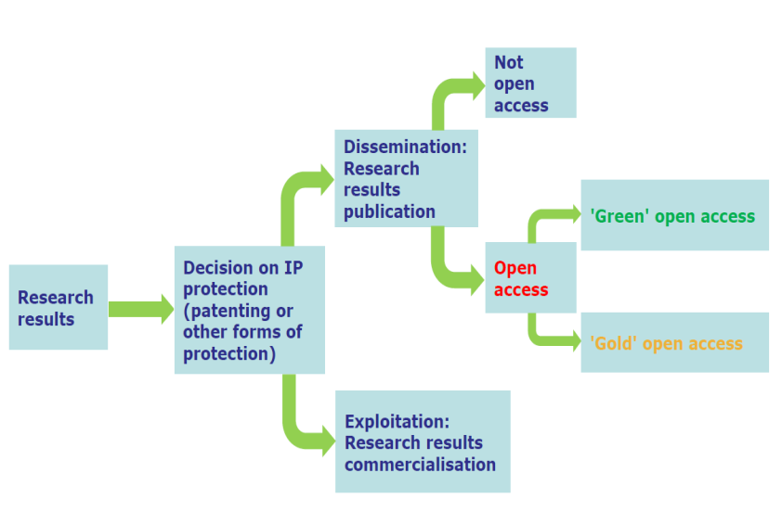

Slide 15
Open Access (II)
The European Commission has published a fact sheet and guidelines on Open Access to Scientific Publications and Research Data in Horizon 2020, that can be downloaded at:
https://ec.europa.eu/programmes/horizon2020/sites/horizo n2020/files/FactSheet_Open_Access.pdf
http://ec.europa.eu/research/participants/data/ref/h2020/gr ants_manual/hi/oa_pilot/h2020-hi-oa-pilot-guide_en.pdf
For more guidance and support on Open Access: the OpenAIRE initiative aims to support the implementation of the Open Access policies of the European Commission and the European Research Council. https://www.openaire.eu/

Slide 16
General obligation to exploit
Not applicable for partners that are not receiving EU funding
Each beneficiary must – up to four years after the project's completion – take measures aiming to ensure the ‘exploitation’ of its results (either directly or indirectly, for instance through transfer or licensing) by:
(a) using them in further research activities (outside the given action);
(b) developing, creating or marketing a product or process;
(c) creating and providing a service, or
(d) using them in standardisation activities.

Slide 17
Transfer/Licensing of results (I)
Each project participant may transfer ownership of its results.
Remember: obligation to notify the other interested partners. A project participant that intends to transfer ownership of results must give at least 45 days advance notice to the other project partners that still have (or may still request) access rights to the results.
Unless otherwise agreed (in writing), any other project participant may object within 30 days of receiving notification, if it can show that the transfer would adversely affect its access rights.
In this case, the transfer may not take place until an agreement has been reached between the project partners concerned.
Remember: obligation to pass on all obligations over the results (protection, dissemination, access rights…) to the transferee and any subsequent transferee.

Slide 18
Transfer/Licensing of results (II)
Each project participant may grant licences to its results. Exclusive licences for results may be granted only if all the other project participants concerned have waived their access rights.
If you intend to transfer results (or grant exclusive licences) to a third party established in a non-EU country non-associated to Horizon 2020:
If a clause to this effect is included in the GA, a project participant that intends to transfer ownership or grant an exclusive licence to third parties established in non-EU, non-associated countries must formally notify the EC before the intended transfer or licensing takes place and:
identify the specific results concerned;
describe in detail the new owner or licensee and the planned or potential exploitation of the results, and
include a reasoned assessment of the likely impact of the transfer or licence on EU competitiveness and its consistency with ethical principles and security considerations.
Remember that the EC may object to such transfers for up to 4 years after completion of the given action!

Slide 19
Thank you for your attention!

